Slide 1
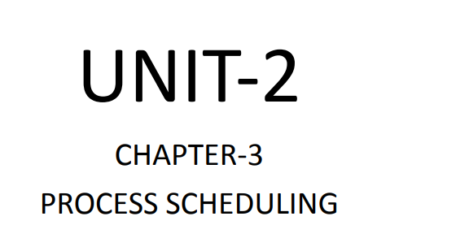
Dept. of CSE(CS), MSRIT

Slide 2
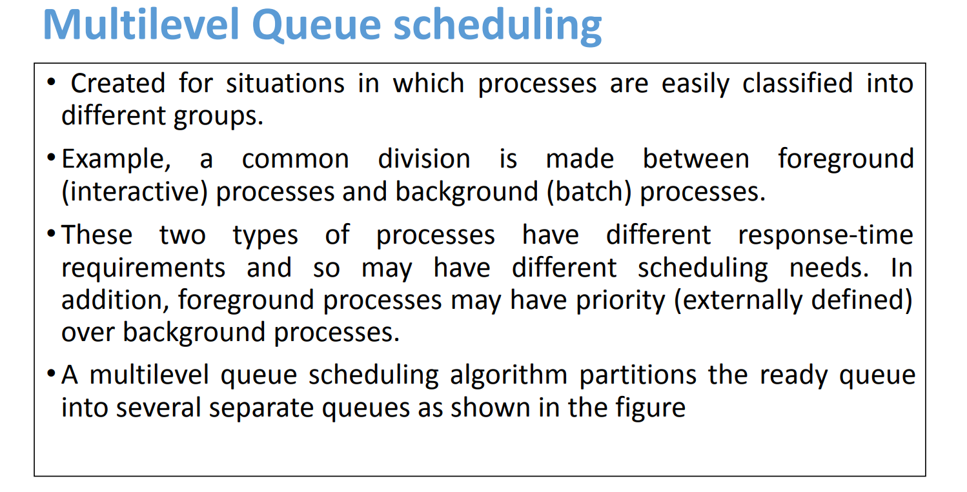
Dept. of CSE(CS), MSRIT

Slide 3
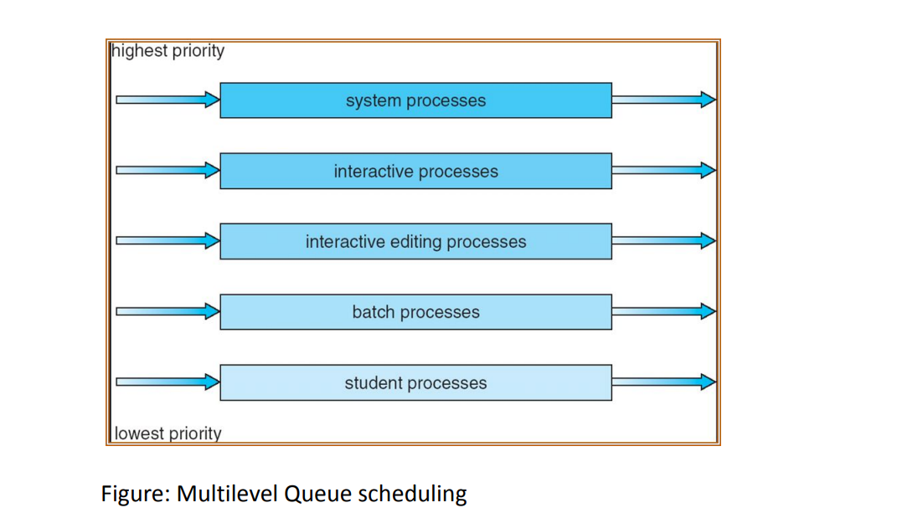
Dept. of CSE(CS), MSRIT

Slide 4
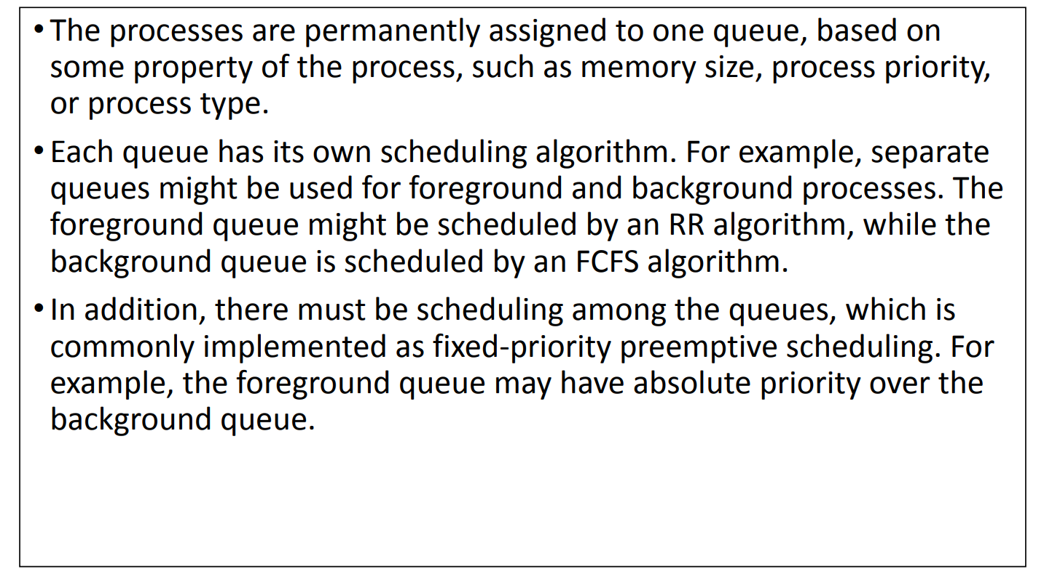
Dept. of CSE(CS), MSRIT

Slide 5
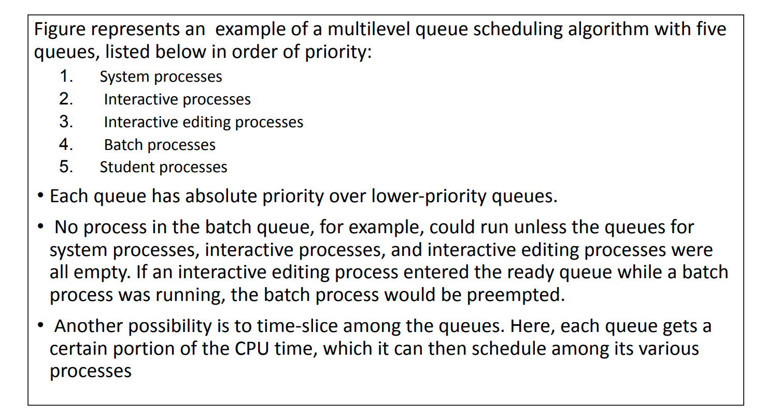
Dept. of CSE(CS), MSRIT

Slide 6
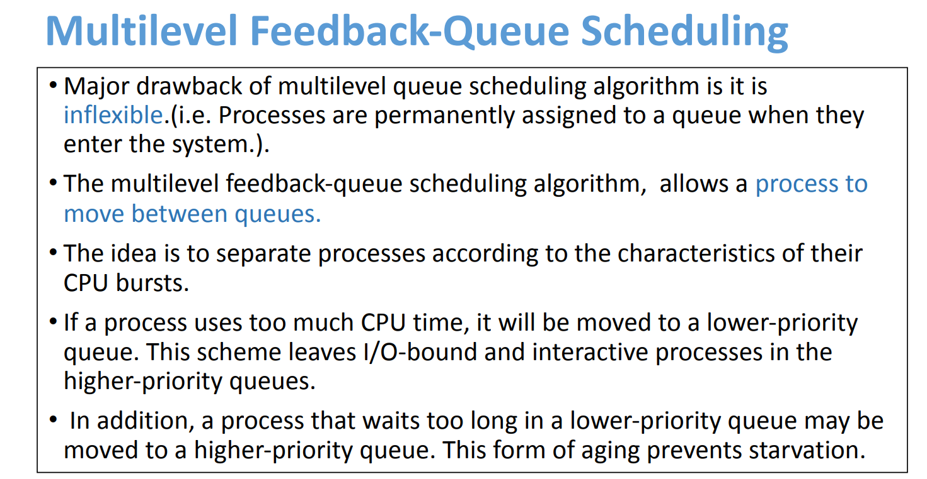
Dept. of CSE(CS), MSRIT

Slide 7
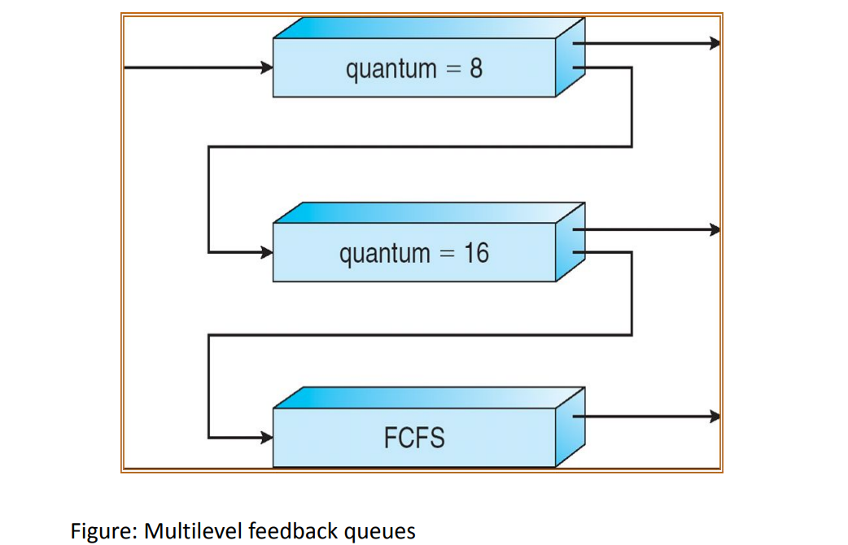
Dept. of CSE(CS), MSRIT

Slide 8
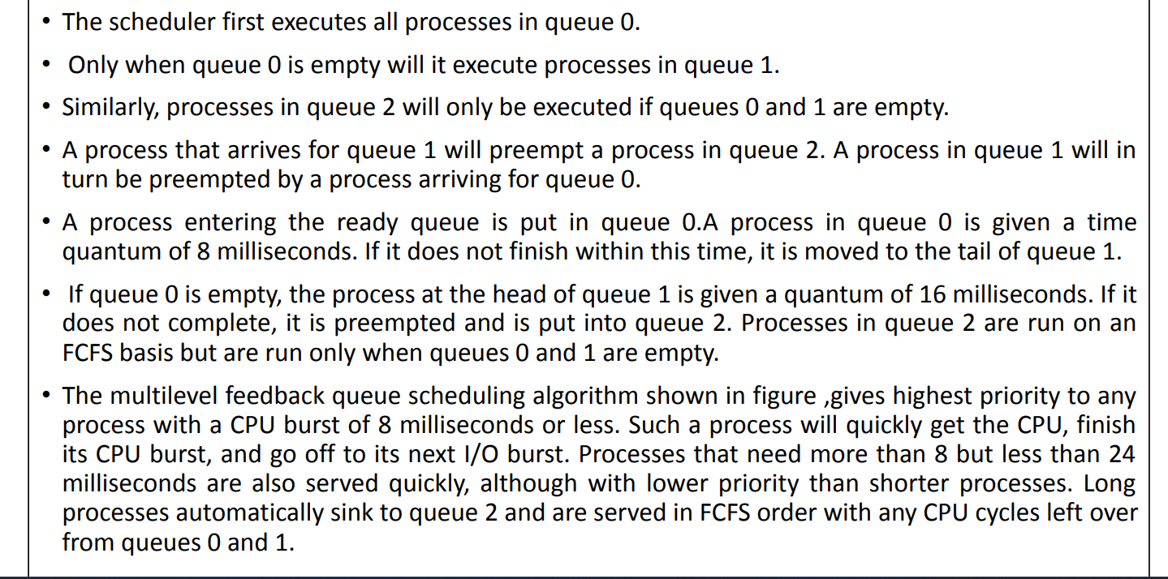
Dept. of CSE(CS), MSRIT

Slide 9
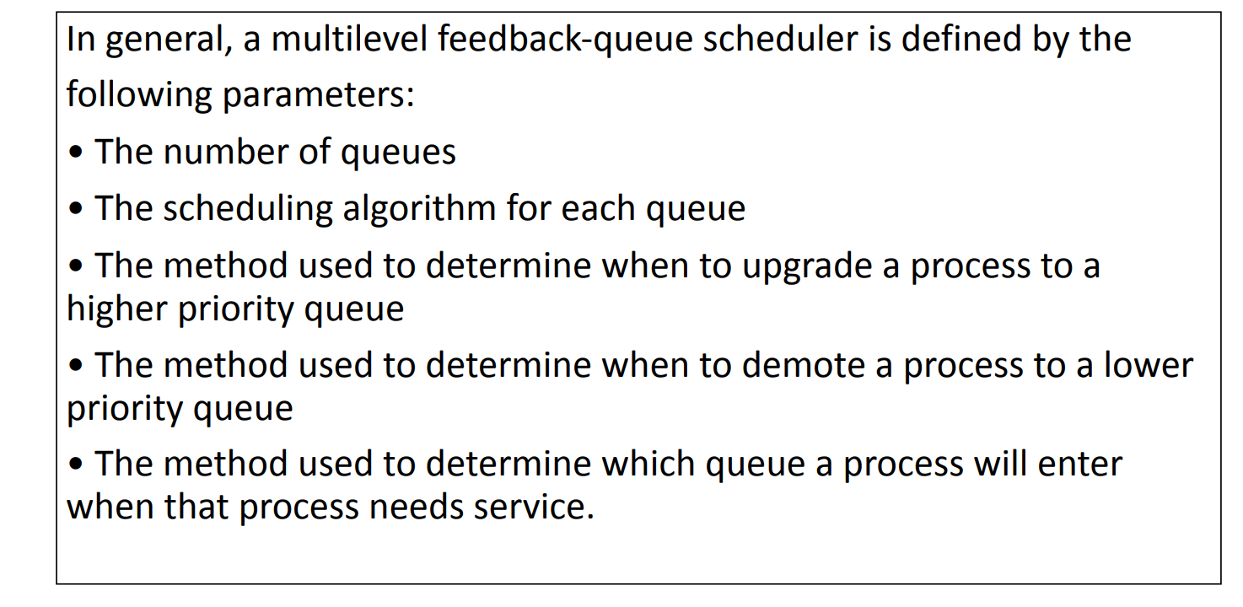
Dept. of CSE(CS), MSRIT

Slide 10
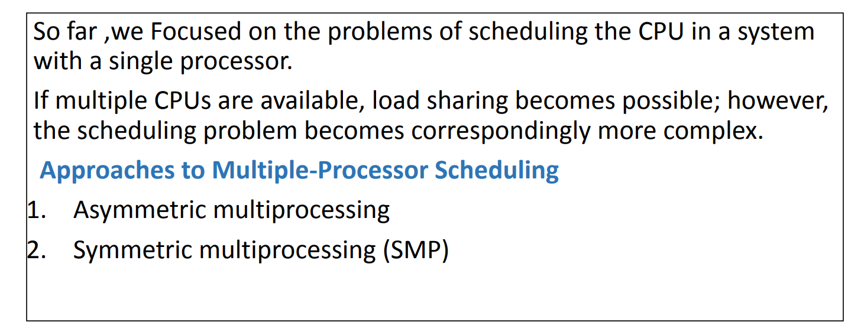
Multiple -processor Scheduling
Dept. of CSE(CS), MSRIT

Slide 11
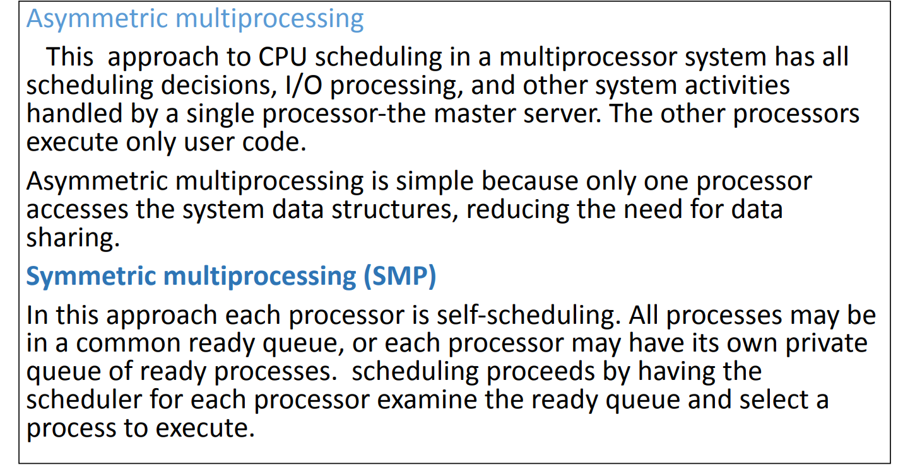
Multiple -processor Scheduling
Dept. of CSE(CS), MSRIT

Slide 12
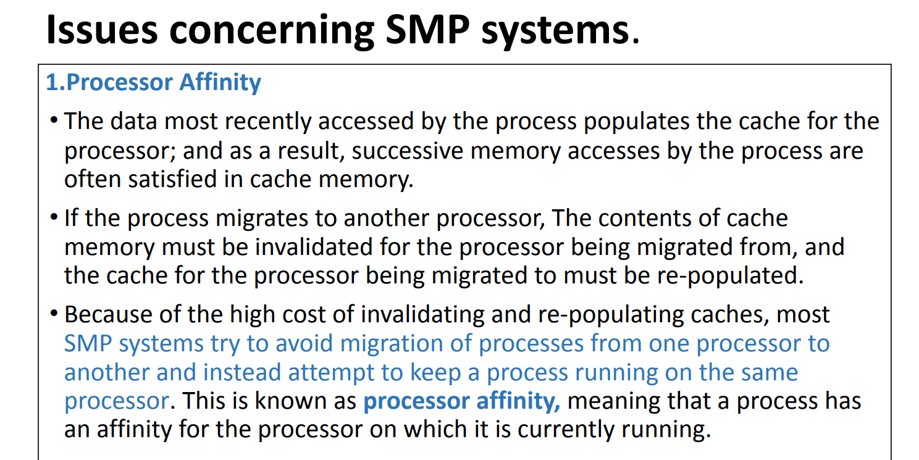
Multiple -processor Scheduling
Dept. of CSE(CS), MSRIT

Slide 13
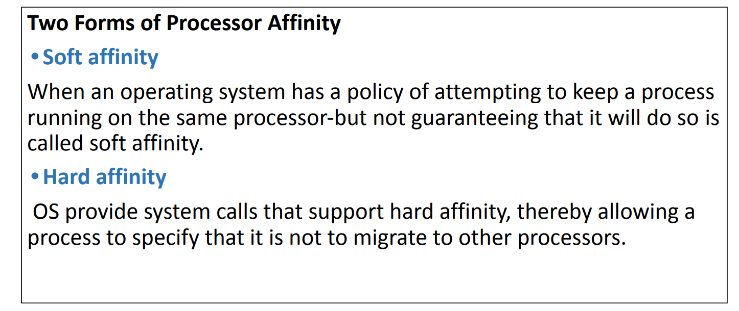
Multiple -processor Scheduling
Dept. of CSE(CS), MSRIT

Slide 14
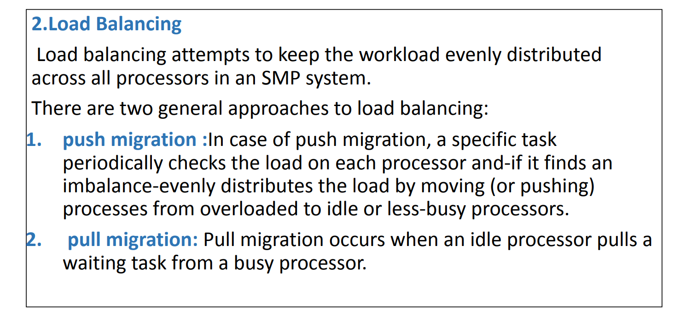
Multiple -processor Scheduling
Dept. of CSE(CS), MSRIT

